Slide 1


FINAL PROJECT PRESENTATION

Slide 2

AGENDA
Impetus of Project
Mission Statement
Project objectives
Deliverable & Objective Alignment
Deliverables:
Dashboard
Recommendation report
User Manual
Rhetorical & Design Strategies
Takeaways

Slide 3

Impetus of Project
PROBLEM STATEMENT
Who? | ●Salsarita’s Fresh Mexican Grill ●Leadership and customers
What? | ●Outdated dashboard ●No visibility into customer sentiment scores ●No visibility into guest comment history ●No capability for proactive intervention
Why does it matter? | ●Poor strategic decision making ●Missed customer service issues ●Inability to identify trends
What is the impact? | ●Inconsistent customer experience ●Reduced customer satisfaction ●Missed opportunities for improvement

Slide 4
Impetus of Project
Core Problem
Solution
No timely, actionable visibility into customer experience data.
Reporting frequency prevents trend analysis.
No centralized way to track :
Guest comment history
Customer sentiment scores
Scores over time
Centralized customer experience analytics dashboard
Provides continuous, up-to-date visibility into performance
Enables monitoring of trends and store-level performance
Integrates customer feedback and complaint tracking
Supports early identification of issues and proactive intervention

Slide 5
Mission Statement
Design and demonstrate a centralized customer experience analytics solution for Salsarita’s Fresh Mexican Grill that improves visibility into customer experience survey performance, strengthens customer service tracking, and enables more timely, data-driven decision making.

Slide 6
Project Objectives
Increase frequency of customer experience scores. From semiannual → weekly ~ 3 months.
Reduce number of compensation coupons issued for unsresolved service complaints by 50% ~ 6 months
Enable identification of declining store-level customer sentiment within one week of occurrence ~ 3 months

Slide 7
Deliverables → Objective Alignment
Deliverable | Key Feature | Objective Supported
Dashboard | Real-time data visualization | Increase insight frequency (semiannual → weekly)
Dashboard | Trend analysis (time series) | Identify declining performance within one week
Dashboard | Complaint tracking & sentiment analysis | Reduce repeat customer issues
User Manual | Step-by-step instructions + plain language | Ensure usability and adoption
Recommendation Report | Suggestions for improving research methods | Support strategic decision-making

Slide 8
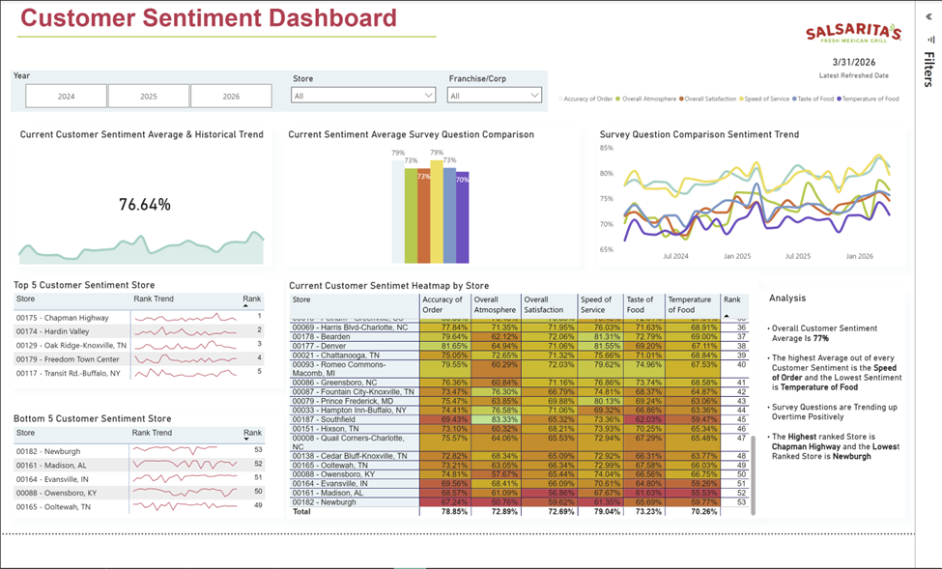
Deliverables
Dashboard

Slide 9
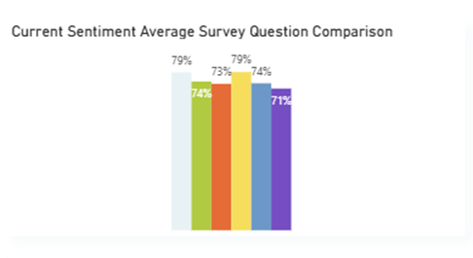
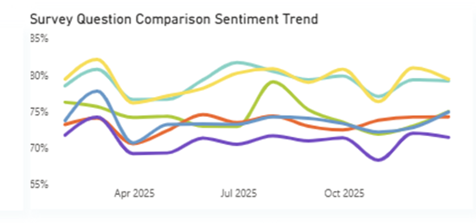
Deliverables
Dashboard
Interactive filters
Year and store selection for targeted analysis
Customer sentiment overview
Real-time average and historical trends
Enables quick performance assessment
Survey performance comparison
Identifies strengths and weaknesses across service areas

Slide 10
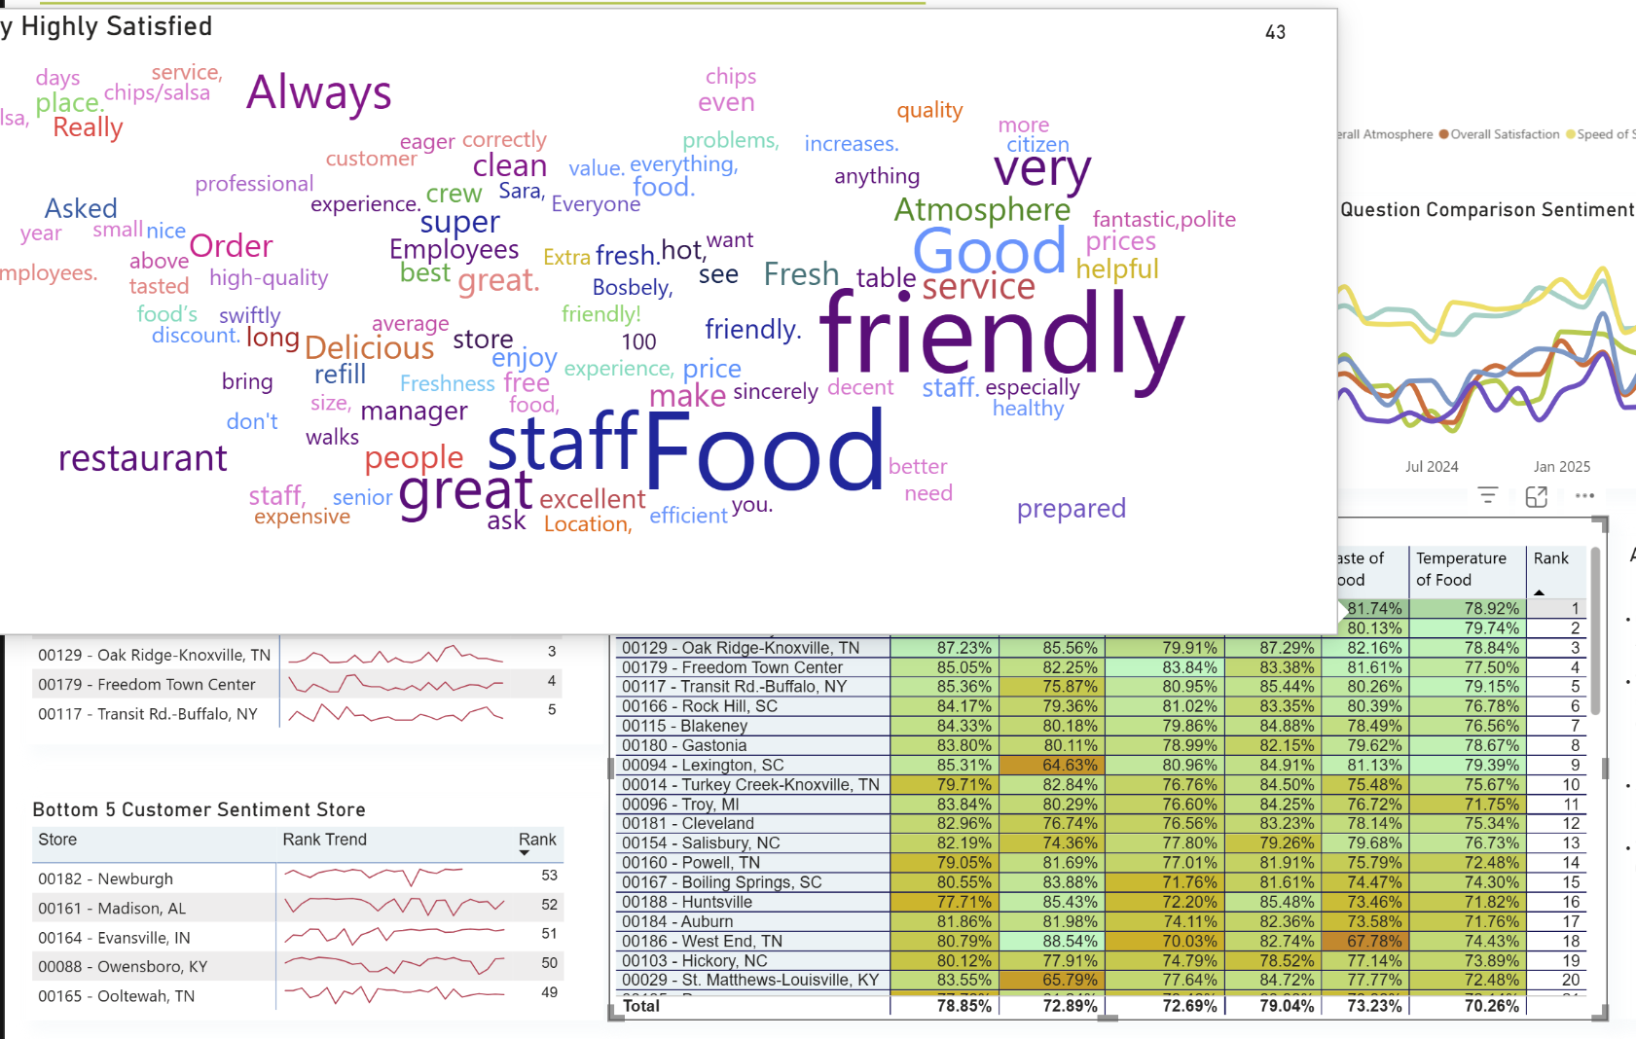
Deliverables
Dashboard
Trend analysis
Tracks changes over time to detect performance shifts early
Store-level performance insights
Top and bottom performers
Supports prioritization of interventions
Heatmap visualization
Highlights high and low performance across stores and categories
Enables fast identification of problem areas
Word cloud displays customer sentiment

Slide 11
Deliverables
User Manual
User Manual Design and Structure
Developed to support end users of the Power BI dashboard
Clear, concise, and easy-to-follow instructions
Includes step-by-step guidance for:
Installing Power BI and opening the dashboard
Navigating and understanding dashboard sections
Organized with headings, bullet points, and simple language

Slide 12
Deliverables
User Manual
Dashboard Usage and Maintenance
Explains all dashboard sections (filters, trends, store performance, heatmap)
Helps users interpret customer sentiment and make decisions
Includes instructions for monthly SMG data updates:
Download survey data from SMG system
Load file into Power BI
Refresh dashboard
Supported with visuals/screenshots for each step

Slide 13
Deliverables
Recommendations Report
Purpose: Offers recommendations for improving insights from customer survey
Options: Present 3 options for client
1. Increase knowledge of research techniques
2. Adopt Net Promoter Score (NPS) infrastructure
3. Embrace both approaches
Recommendation: Suggested Option 3
Easily implemented with low-cost
Highlights transferability of survey structure
Encourages more accurate business interventions

Slide 14
Rhetorical & Design Strategies
Dashboard
Designed for quick decision-making
Visual hierarchy highlights critical data
Minimal text, high visual clarity
User Manual
Plain language for accessibility
Step-by-step structure
Visual aids to reduce user error
Report
Structured argument format
Data-supported recommendations
Clear and personable communication

Slide 15
Key Takeaways
Lessons Learned:
Early alignment on metrics is critical → Promoter & detractors definition
Structured task planning improves execution
Technical constraints must be anticipated
Collaboration Insight
Constraints required cross-team coordination
Manual development validated dashboard functionality
Feedback improved both dashboard and documentation
Key Insight: Integrated teamwork enhances deliverable quality

Slide 16
Thank You!

